Slide 1

An Adaptive Property-Aware HW/SW Framework for DDDAS
Iowa State University, Ames IA
PI: Phillip Jones
Co-PIs: Joseph Zambreno, Nicola Elia
Students: Chetan Kumar N G, Sudhanshu Vyas, Matt Rich
Washington University, St. Louis MO
PI: Ron Cytron, Co-PI: Chris Gill
Student: Jonathan Shidal
AFOSR: Grant # FA9550-11-1-0343

Slide 2
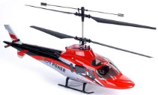
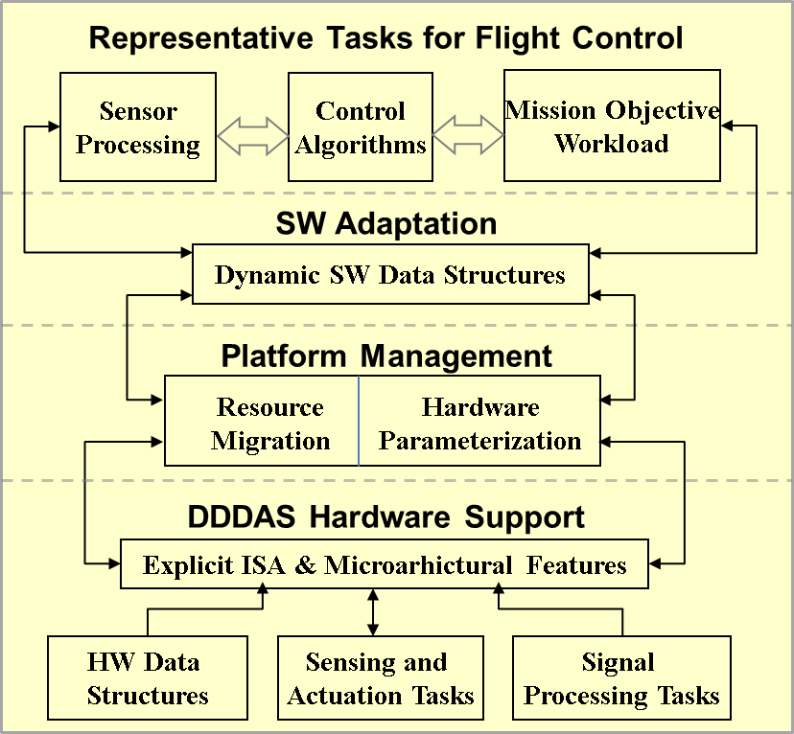
Overview
In-flight data-driven applications must respond to surprise
  Changes in mission objectives
  Unexpected friends or foes
  Changes in environment
Modalities
  Real-time
  High-performance
  Energy-conserving
Focus areas
  Data structures: spanning HW/SW boundaries & Dynamic
  ISA extensions and hardware support
  Establish performance metrics
Notes:
This project focuses on the design of an adaptable computing infrastructure to support DDDAS systems in the context of Unmanned Aerial Vehicles (UAVs). A unifying theme that drives our research is the concept of responding and adapting to surprise. Some examples of surprise are: 1) in flight changes in mission objectives, 2) unexpected encounters with friends or foes, and 3) changes in the environment. Two examples of environmental changes could be a chipped blade (which changes the dynamics of the UAV), or unexpected turbulence.
In support of responding to surprise, research is being pursued to allow elements of the computing platform to adapt to the system or tasks moving between different modalities (e.g. real-time, high-performance, small-footprint, Energy-conserving).
Key areas of focus that support adaptation to surprise and changing modalities are:
Data structures that span HW/SW boundaries: In this area we are exploring SW data structures that can dynamically change their internal makeup to best suite a task’s current modality (e.g. maximizing average throughput when in high-performance mode, or bounding worst-case access time when in a real-time mode), or migrating their storage and operators between SW/HW boundaries to improve performance and/or improve predictability.
Instruction Set Architecture (ISA) extensions and hardware support: This area focuses on the design and evaluation of specialized hardware to support common tasks that can be found in UAV applications (e.g. sensor acquisition/processing, issuing actuator commands, signal processing, vehicle controller logic) for the purpose of increased computational efficiency (explicitly exploiting concurrency) and/or enforcing guarantees on task behavior (e.g. tight bounds on execution variation, guarantees on resources availability)
Establishing performance metrics: i) tolerance of vehicle stability to jitter in its control loop, ii) overheads associated with dynamically morphing data structures or migrating them across SW/HW boundaries.

Slide 3

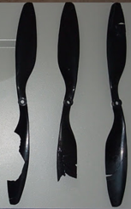

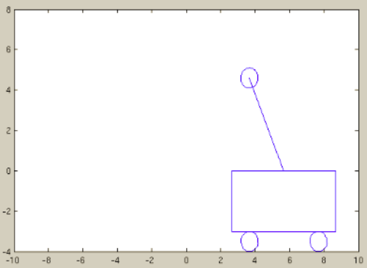
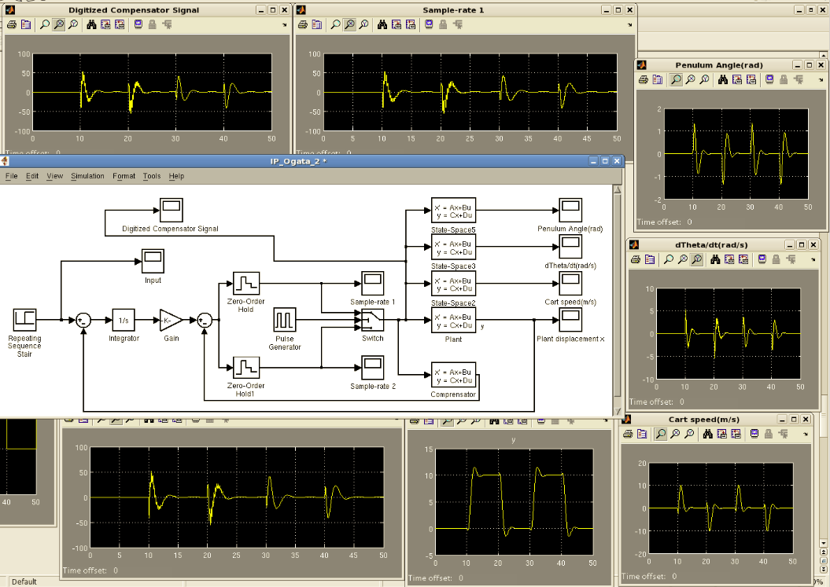
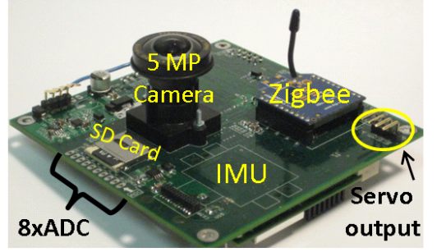
Approach and Methods
Create representative “surprise” scenarios
Map to simplified vehicle model
  Quantify impact of computation response to surprise on vehicle dynamics
Develop dynamic HW/SW mechanisms to mitigate impact of surprise
  E.g. dynamic data structure, hardware adaptation
Evaluate mechanisms
  C models
  MATLAB-Simulink
  FPGA prototypes
Vehicle Position Stability
Simulink Vehicle Model
FPGA Experimentation
Notes:
This slide illustrates at a high level the approach this project is taking
Developing “surprise” scenarios”: To evaluate our mechanisms that support DDDAS type applications, we use scenarios to construct system workloads. Three example small-UAV-based scenarios are:
Unexpected turbulence occurring due to gusting winds.
The vehicle undergoing a change in its physical dynamics (e.g. a blade chipping causing increased vehicle vibrations)
The vehicle entering an area of unexpected electromagnet interference (e.g. lightning strikes or getting close to large metallic objects) that interfere with certain sensors (e.g. magnetometers used for determining direction)
Mapping UAV to a simplified vehicle model: For initial experimentation and evaluation, a standard simple inverted pendulum on a cart serves as a MATLAB/Simulink testbed for implementing our representative “surprise” scenarios.
This allows the opportunity to focus on the design and behavior of our dynamic data structures and DDDAS support mechanisms on a relatively simple vehicle model and controller, before applying them to more complex UAV models and controllers.
Initial application of our techniques to a simple vehicle model allows us to build intuition on the interactions between our computing mechanisms, sensor behavior, and vehicle dynamics that will help guide our analysis as we move into using the more complex UAV models
The MATLAB/Simulink testbed is being developed in such a way that the inverted pendulum model and controllers are easily swappable for more advanced vehicle models and controllers.
Development of dynamic HW/SW mechanisms to mitigate impact of surprise: The mechanisms pursued will allow selected SW and HW resources of the computing platform to dynamically adjust to the needs of the application.
Adapting the storage/functionality of computation to tradeoff resource allocation for computing speed and/or guarantees in computing properties (e.g. throughput vs. deterministic timing).
Placing and managing Priority Queues in SW vs. HW, and potentially migrating between the two.
Migrating between different configurations of trees: e.g. Red-black to AVL.
Using the concept of dynamic stream filters to trade off throughput for accuracy (e.g. filtering data quickly vs. accurately).
Evaluating DDDAS Application support mechanisms:
a) The research will follow an incremental approach for evaluating our DDDAS support mechanisms. Beginning with initial SW and MATLAB/Simulink models, and incrementally moving these models into a prototype of an actual UAV system using an FPGA-based platform to host our DDDAS-centric System-on-Chip architecture.

Slide 4
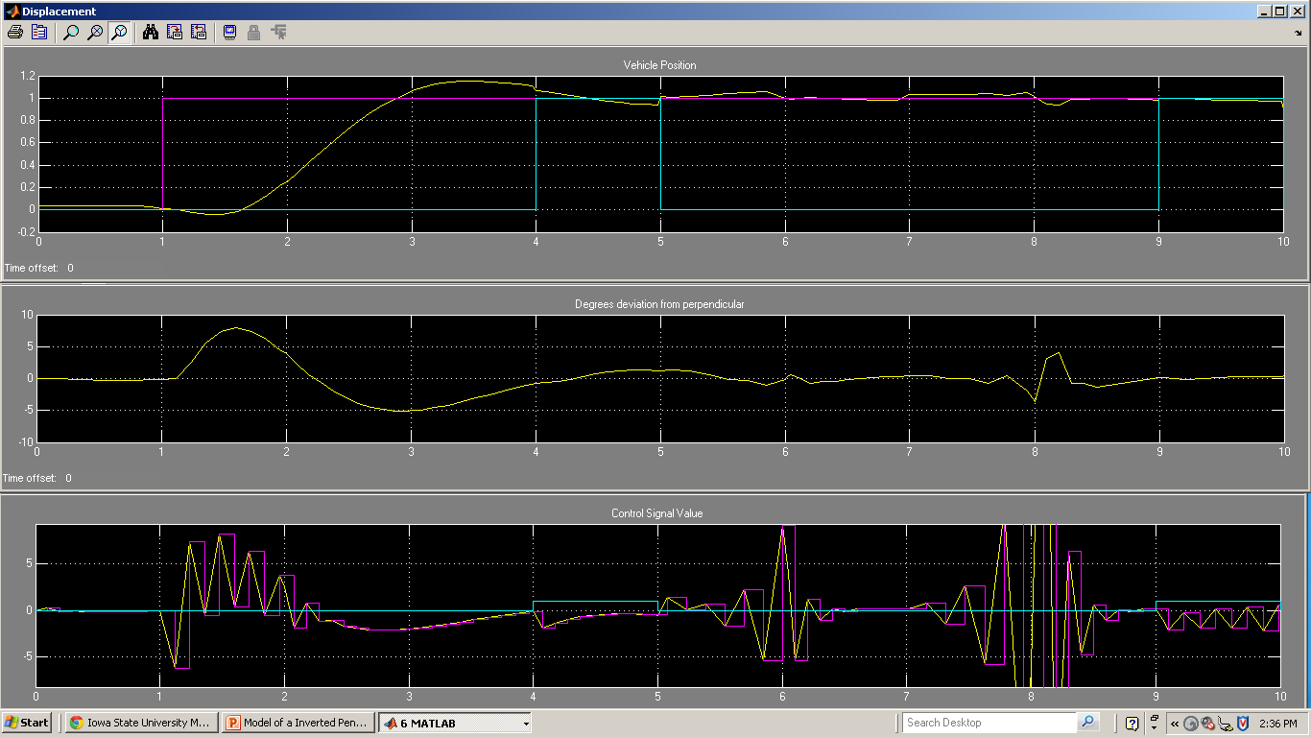
Performance Metrics for Evaluation
DDDAS applications: couples data streamed and its processing.
In addition to standard metrics (e.g. worst case task execution for schedulability analysis), metrics are needed to embody coupling.
  Impact of variations in control loop execution (i.e. timing jitter) on vehicle stability
    Controller settling time and overshoot metrics as a function of timing jitter
  Minimum allocation of computing resources to tolerate given surprise scenarios
    Minimum sensor sample rate needed to tolerate a 50 mile/hour gust of wind.
Wind gust
Vehicle Position (ft)
Goal
Position
Disturbance
Position
Controller Output Force (N)
Pulsed Force
Time seconds
Notes:
Metrics are needed that can evaluate the symbiotic relationship between data streaming from sensors and how that data is processed.
An example of using a simplified model (Inverted pendulum on a cart) to gather preliminary data with respect to identifying relevant metrics that map to realistic UAV scenarios, and gaining intuition about these metrics.
In this case we determine though a MATLB/Simulink simulation the minimum sample rate needed to withstand an emulated 1 N gust of wind that lasts for one second (at time 4 seconds). We show the behavior of the system at a sample rate just below the minimum required. Resulting in the Controller almost recovering at 6 seconds, but slowly goes unstable from time 7 to 8 seconds. The vehicle is trying to maintain a horizontal position of 1 foot.
Potentially the output streaming from the Controller, or sensors monitoring wind speed, or sensors that can detect a pulse disturbance (e.g. gyo’s, accelerometers) on the vehicle could be used as feedback to dynamically adjust the sample rate of sensors (thus increasing computing resources allocation for stabilization) in order to better tolerate surprise disturbances.

Slide 5
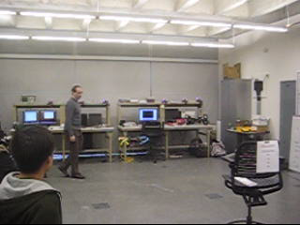
Quadrotor Platform

Slide 6
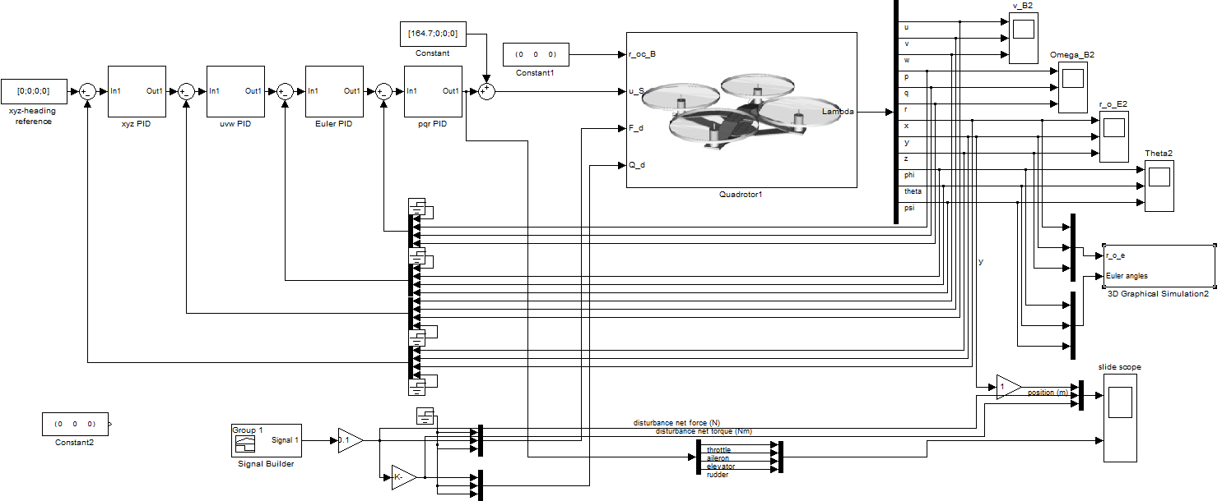
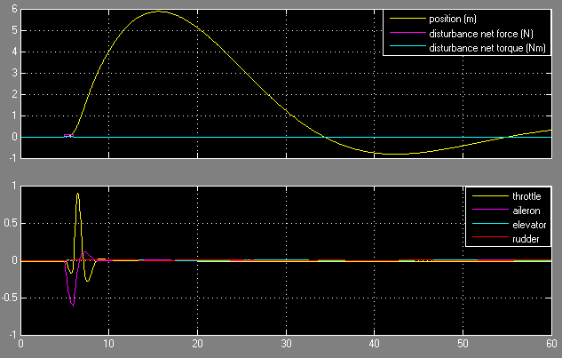
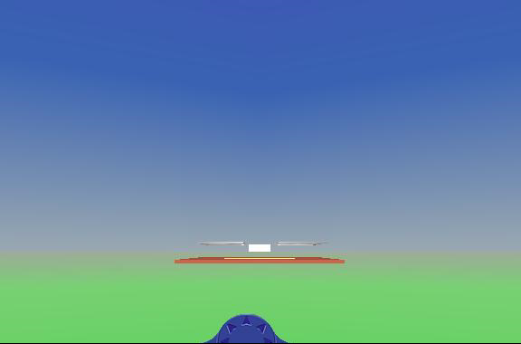
Multilayer PID Control of Quadrotor

Slide 7
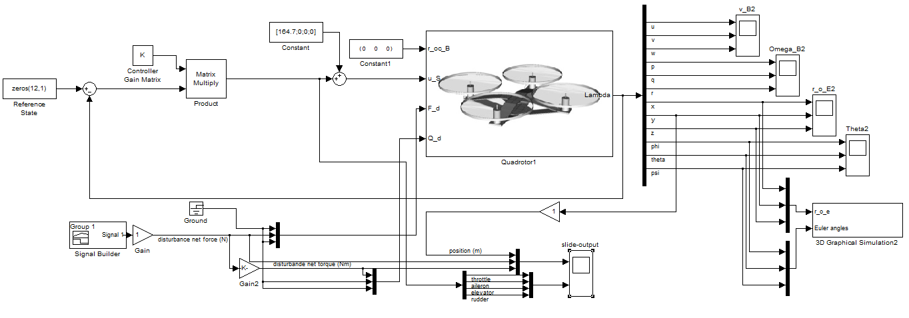
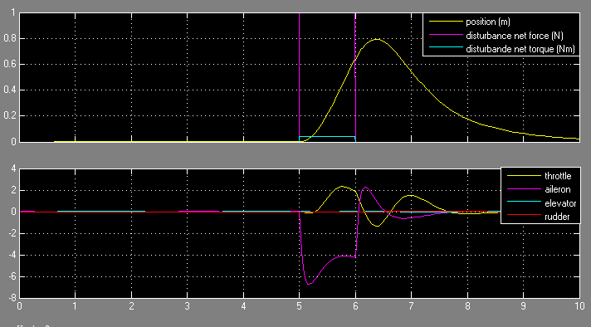
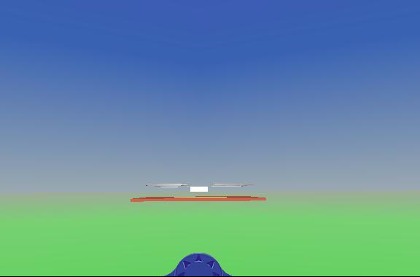
LQR Control of Quadrotor

Slide 8
Dynamic Data Structures
Priority queue: Hardware implementation for real-time controls
  Increasing throughput and reducing jitter
Ordered set: Exploring migration from red-black trees to AVL trees
  Supporting transition between mission modalities.
Adaptation to evolving conditions
Real-time
High-performance
Small
footprint
Notes:
Systems authored for DDDAS require data structures that can migrate between modalities in response to planned mission objectives as well as surprise. We are building on previous work to develop data structures that work well in each modality but that can also migrate between modalities as required.
We are extending our previous work on real-time dictionaries to include storage-frugality and migration between the three modalities shown on this slide.
For the priority queue, we obtain real-time performance by a hardware design consistent with the software/hardware codesign nature of our research. The hardware design is shown on the next slide and we are currently obtaining jitter measurements that compare it with a standard software-only implementation.
For ordered sets (i.e., binary search trees), we are developing algorithms that migrate between red-black trees (fairly well balanced) and AVL trees (very well balanced).
With these data structure implementations in place, applications that use them can intelligently adapt to evolving conditions and exhibit behaviors beyond what is statically specified prior to mission launch.

Slide 9
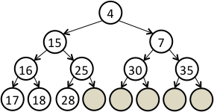
Priority Queue
Is an abstract data structure that at minimum supports two basic operations
  Enqueue – Inserts the element with associated priority to the queue.
  Dequeue – Removes the element with highest priority from the queue
A common software data structure used to implement a priority queue is the binary heap
  Elements are stored as a linear array where the first element corresponds to the root.
  Given an index ’i’ of an element, ’i/2’, ’2i’ and 2i+1 are the indices of its parent, left and right child respectively.
  Supports Enqueue and Dequeue operations in O(log n) time.
An example of a min-heap based priority queue is shown below, where a lower key value corresponds to a higher priority.
=
4
15
7
16
25
30
35
17
18
28
index 4 8 9

Slide 10
20
Hardware Priority Queue Architecture
Hardware implementation of a conventional binary heap.
Supports enqueue in O(1) time and dequeue in O(log n) time.
Enqueue Logic
New Entry
Queue Manager
Cell0
Cell1
Cell2
Cell3
Level0
Dequeue Logic
Address Decoder
4
Mux/
DeMux
>=
Level1
15
7
>=
Level2
16
25
30
35
Level3
17
18
28
Block RAMs
Enqueuing
Each level of the heap is stored in a separate Block RAM.
Address decoder generates addresses and control signals for the BRAMs.
Queue Manager provides the necessary interface and executes operations on the queue.

Slide 11
Hardware Priority Queue Architecture
Hardware implementation of a conventional binary heap.
Supports enqueue in O(1) time and dequeue in O(log n) time.
Enqueue Logic
New Entry
Queue Manager
Cell0
Cell1
Cell2
Cell3
Level0
Dequeue Logic
Address Decoder
4
Mux/
DeMux
>=
Level1
7
15
7
15
>=
Level2
35
16
30
35
20
30
Level3
17
18
28
25
Block RAMs
Dequeuing
Each level of the heap is stored in a separate Block RAM.
Address decoder generates addresses and control signals for the BRAMs.
Queue Manager provides the necessary interface and executes operations on the queue.

Slide 12
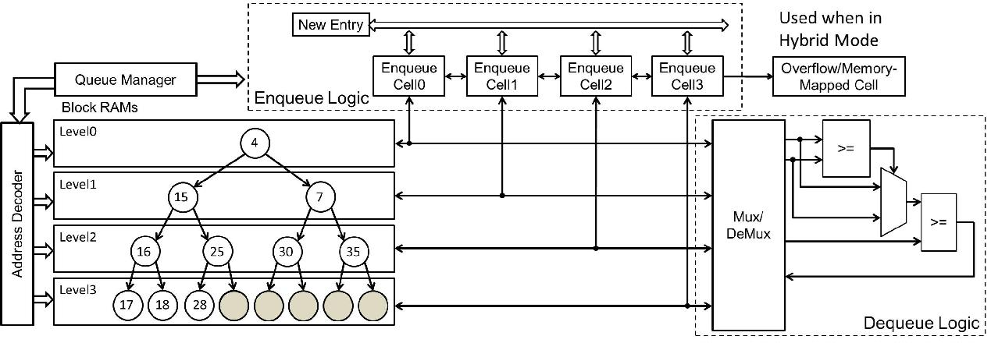
SW/HW Hybrid Priority Queue
Hardware priority queue extended to partially migrate to software memory when queue overflows hardware resources.

Slide 13
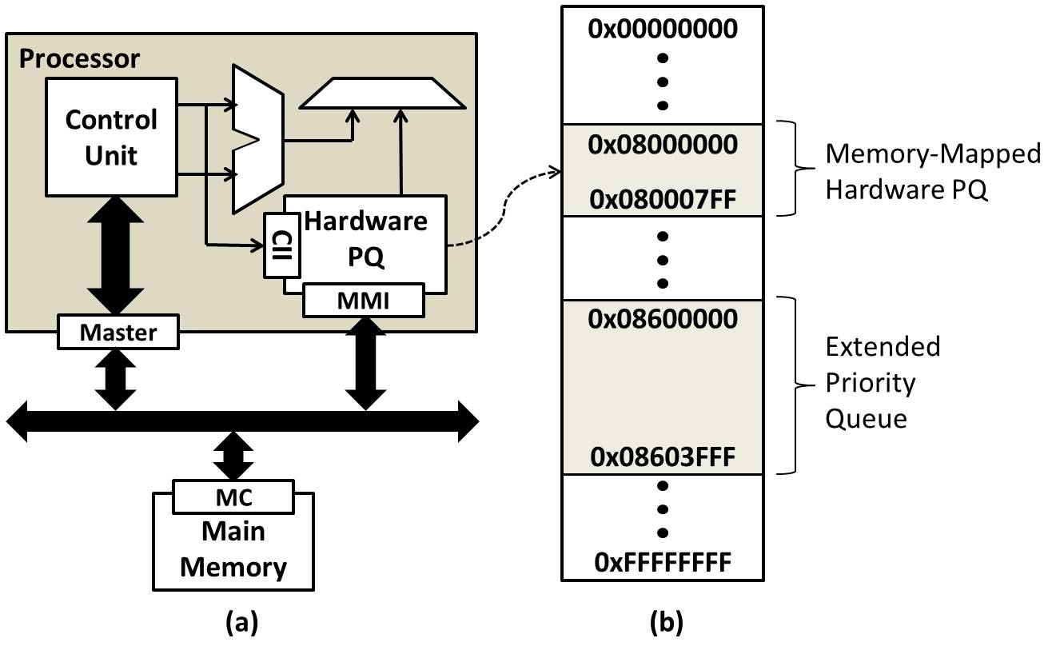
Hybrid Priority Queue
During overflow, priority queue array is extended into software memory.
In hybrid mode, queue is managed in both hardware and software.

Slide 14
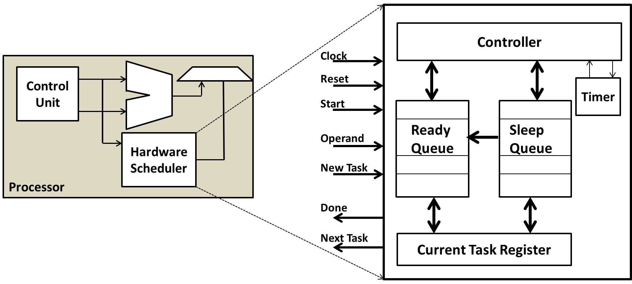
Hardware Scheduler
Designed to reduce the timer-tick processing and scheduling overhead.
Controller
Timer
Ready Queue
Sleep
Queue
Hardware Scheduler
Controller: responsible for the execution of the scheduling algorithm
Timer: keeps accurate high-resolution time.
Task queues: priority queues that keep tasks in sorted order based on their priority (Ready Queue) or activation time (Sleep Queue).
Custom instructions: extend the processor’s instruction set architecture to allow the CPU to interface with the scheduler.

Slide 15
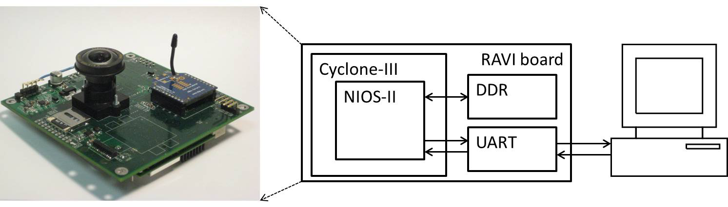
Evaluation Methodology
Platform
Reconfigurable Autonomous Vehicle Infrastructure (RAVI) board, an in-house developed FPGA prototyping platform.
Architecture Configuration
Nios II processor running at 50 MHz.
Custom instruction interface is used to communicate with the scheduler.
Supports up to 255 tasks.
Scheduling algorithm - Earliest Deadline First(EDF).
Workload
Periodic tasks with randomly generated parameters.
Relative task deadline equal to period of the task.
Metrics
Scheduler Overhead
Timer-tick Overhead
Predictability

Slide 16
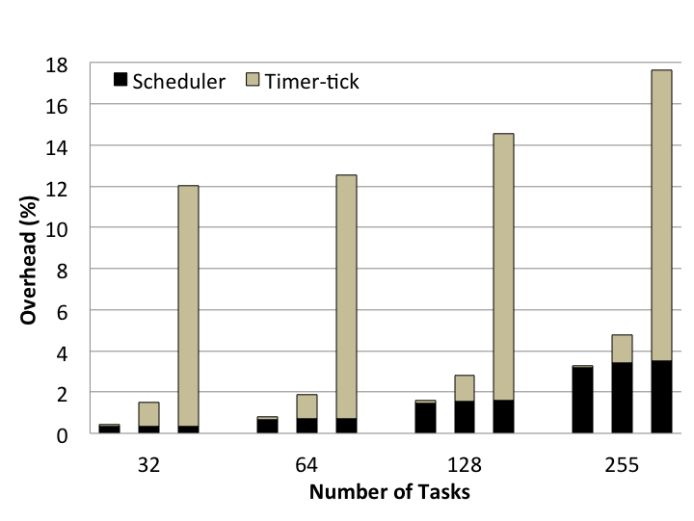
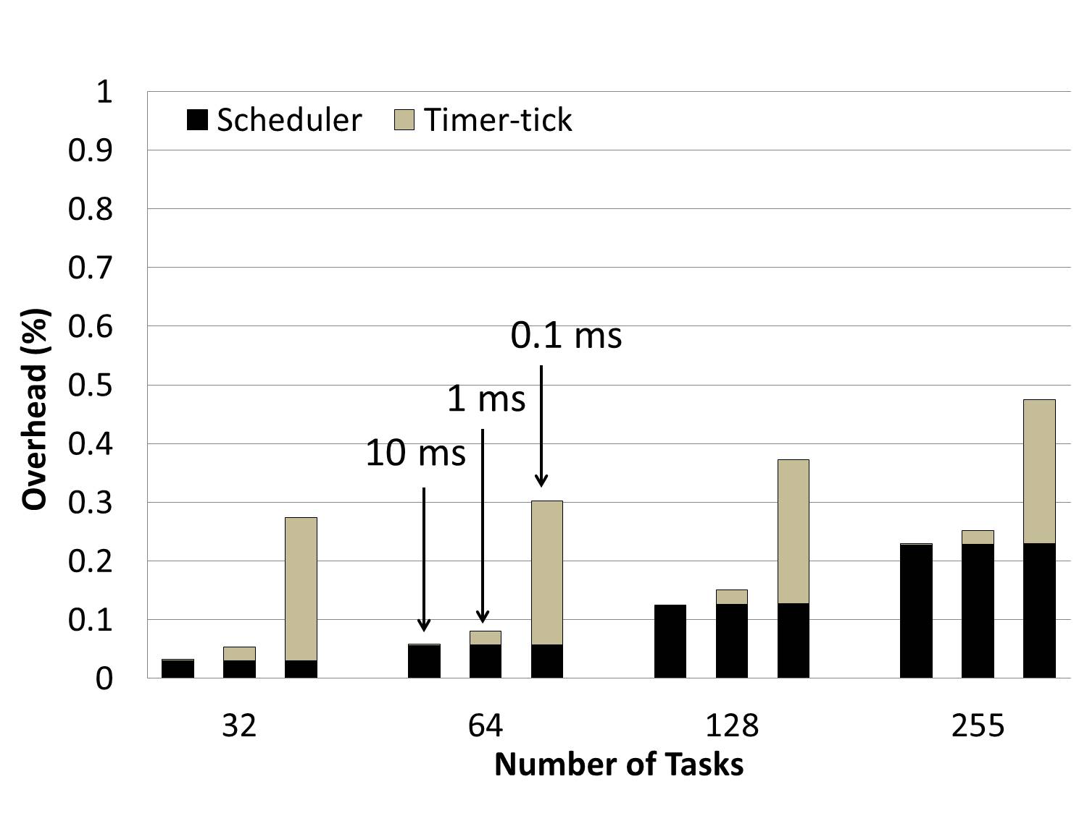
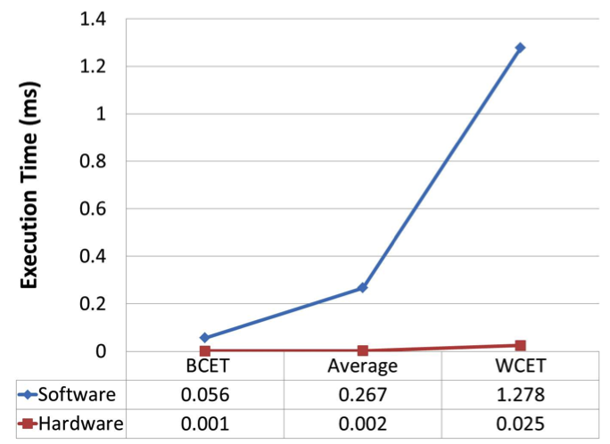
Hardware only - Results and Analysis
Software Scheduler Overhead
Hardware Scheduler Overhead
0.1ms
1ms
10ms
Scalability: Supports up to 255 tasks with high timer tick resolution of 0.1ms.
Overhead: A 97% reduction in scheduling overhead was obtained after migrating the functionality to hardware.
Improved Predictability: Hardware shows 50 times less variability in scheduler execution time, thus providing increased predictability
Variation in scheduler execution time

Slide 17
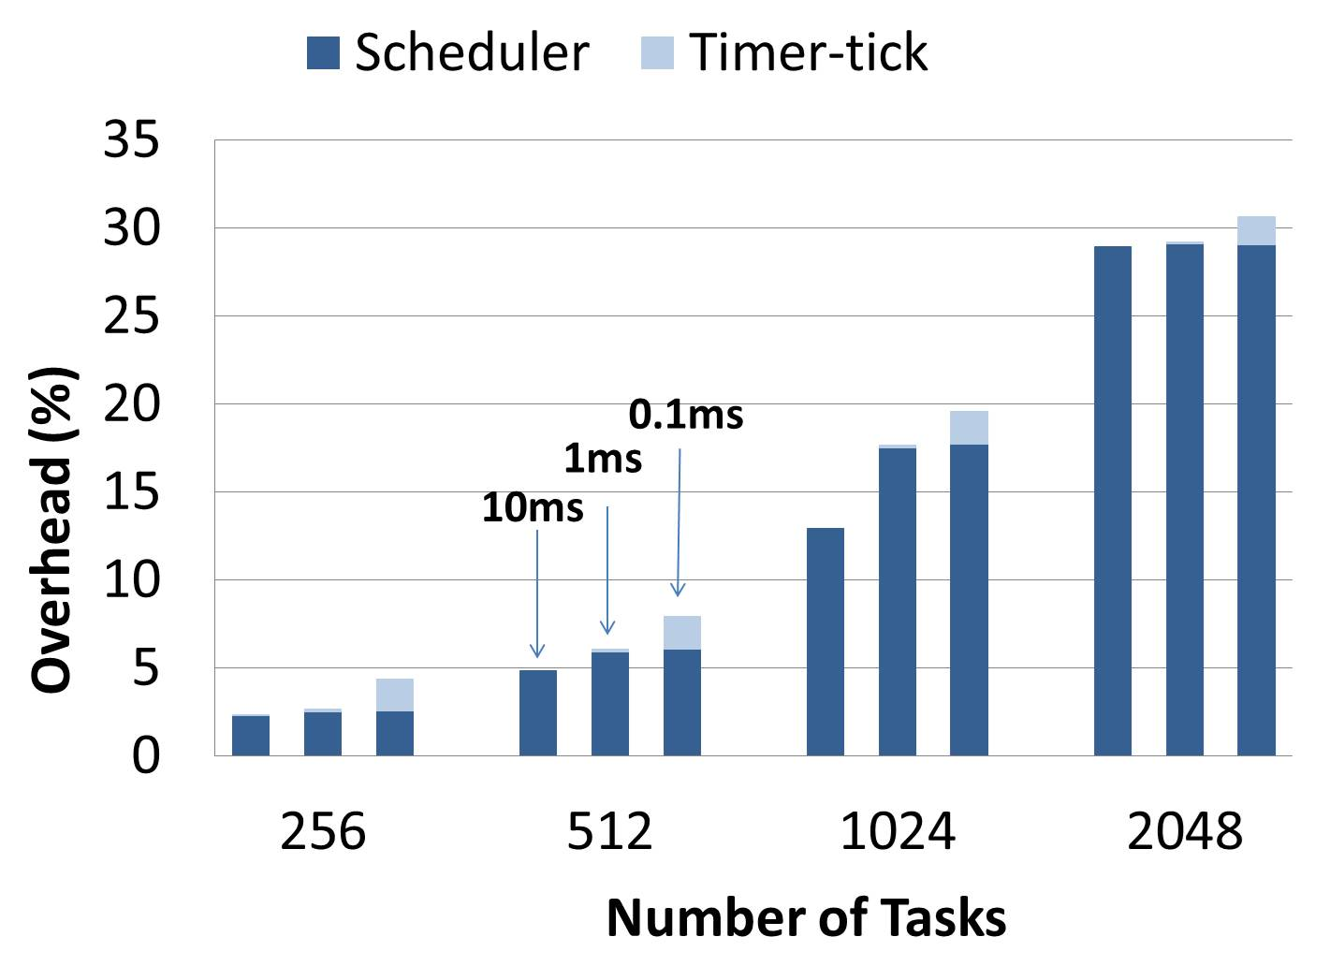
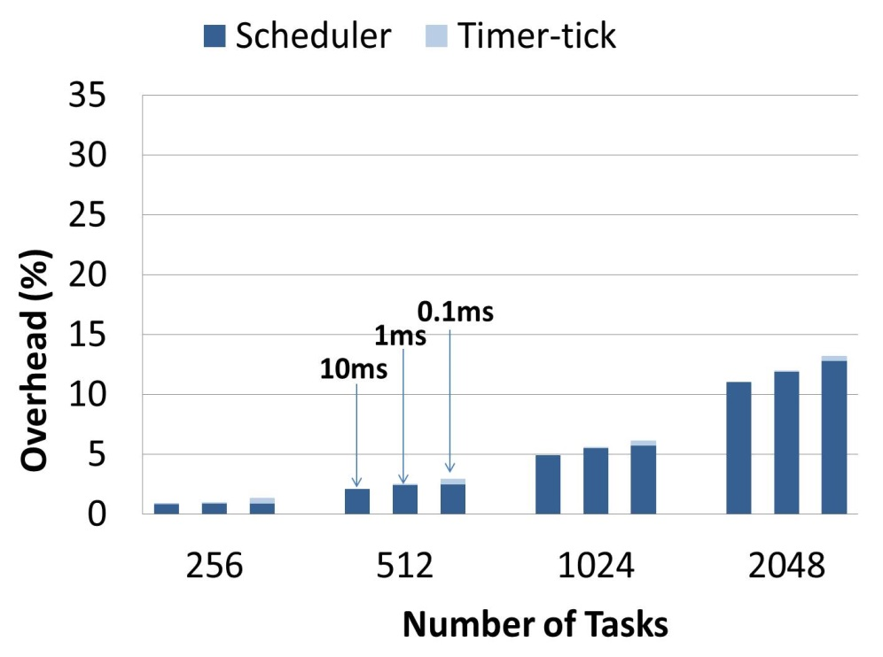
Hybrid – Scheduler Performance
Software Scheduler
Hybrid Scheduler
Scheduler executes in hybrid mode when there are more than 255 tasks.
Hybrid scheduler reduces overhead by more than 50%.

Slide 18
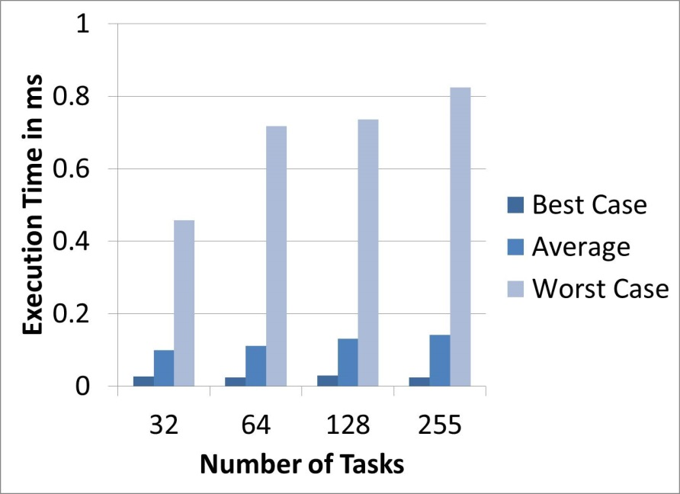
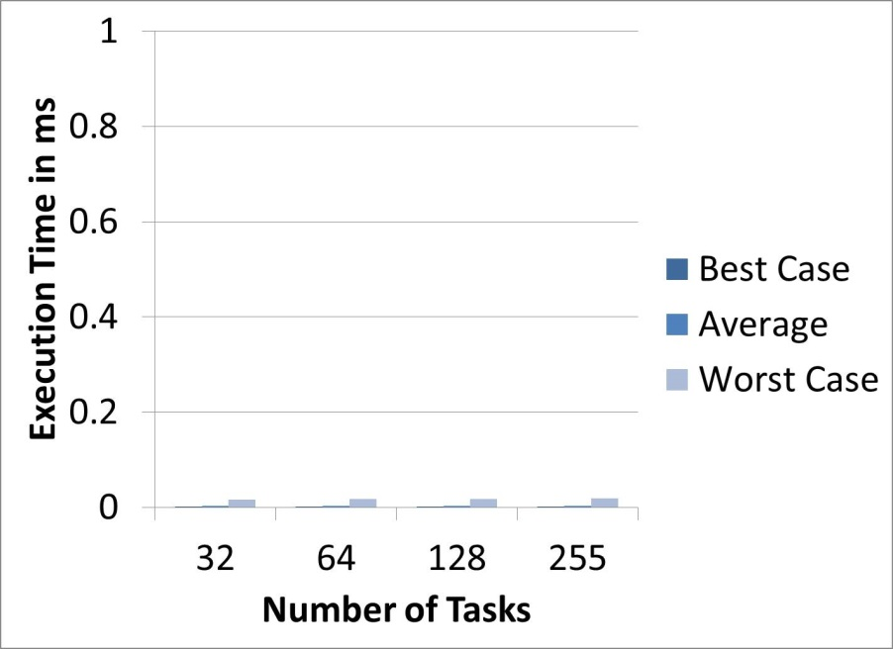
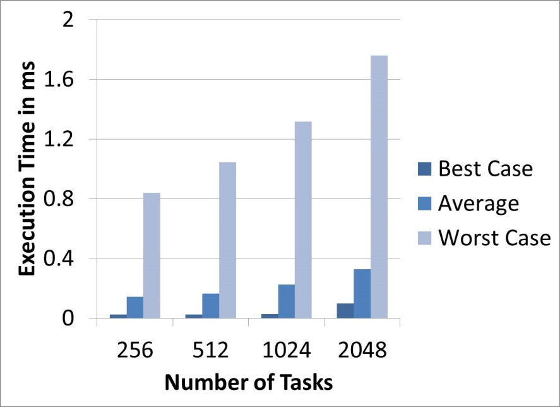
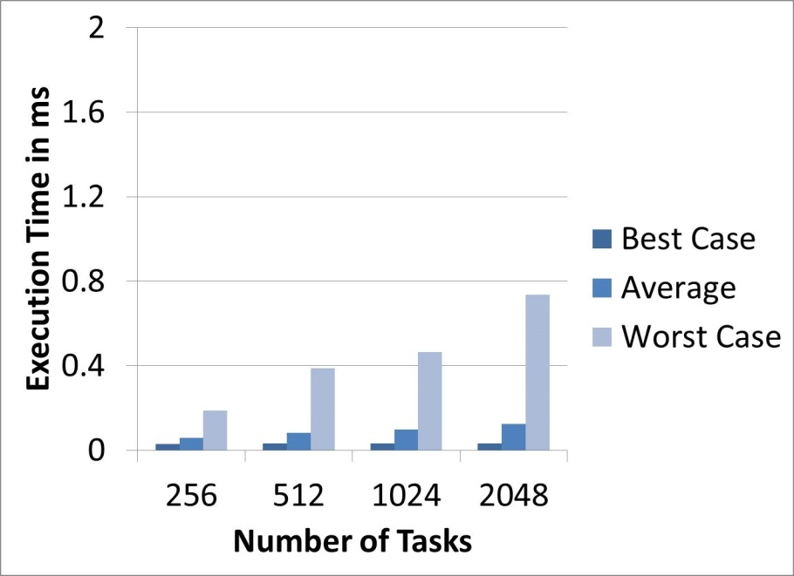
Hybrid – Scheduler Predictability
Software Scheduler
Hardware/Hybrid Scheduler

Slide 19
Adaptation between AVL & Red-Black Trees
 | AVL | Red-Black
Worst case height | 1.44log₂(n+2) - 1 | 2log₂(n+1)
Average search time | Faster, since shorter
Average insert/delete |  | Faster, since looser balancing constraint
Real-time implications
  AVL: Stricter balancing constraints gives better worst-case search time.
Throughput implications
  Red-Black: Looser balancing constrains gives greater throughput for insertion/deletion, since fewer balancing operations required.
  AVL: Shorter tree gives better throughput for search operations.
Controls implications
  AVL: Stricter balancing constraints gives tighter bounds on variation between best-case and worst-case bounds for search, and insert/delete operations.
Can we take advantage of both by efficiently
converting between the two?

Slide 20
Red-black to AVL using medians
Copy red-black tree in order to an array
Construct an AVL tree from the array using a medians approach
  Example using integers 1-6
Red-black tree
Array
AVL tree
2
1
2
3
4
5
6
3
1
4
AVL Construction
1
5
1. Choose and insert median
3
5
2. Move right in array to numbers greater than median to build the right subtree, go back to 1
2
4
6
6
3. No more numbers to right, return to previous median and use numbers less than it to build the left subtree, go back to 1

Slide 21
Results
Experiment: Insert 1 million random integers into each type of tree, convert red-black trees to AVL using our method vs. standard AVL insert method
 | Insertion time | Conversion time | Total | Execution time (Normalized to AVL)
AVL | 1017 ms | No conversion | 1017 ms | 1
Red-Black | 600 ms | No conversion | 600 ms | 0.58
Red-black to AVL (standard) | 600 ms | 623 ms | 1223ms | 1.2
Red-black to AVL (median) | 600 ms | 135 ms | 735 ms | 0.72

Slide 22
Results
Experiment: Insert 1 million random integers into each type of tree, convert red-black trees to AVL using our method vs. standard AVL insert method
 | Insertion time | Conversion time | Total | Execution time (Normalized to AVL)
AVL | 1017 ms | No conversion | 1017 ms | 1
Red-Black | 600 ms | No conversion | 600 ms | 0.58
Red-black to AVL (standard) | 600 ms | 623 ms | 1223ms | 1.2
Red-black to AVL (median) | 600 ms | 135 ms | 735 ms | 0.72

Slide 23
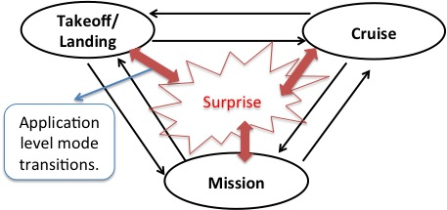
Heterogeneous Mixed Critical Platforms
Identify key modes of operation during design phase.
  Stable states of execution
Test and certify transitions between states.
Adapt to surprise
  Dynamically changing application characteristics.
Modalities
  Real Time
  High Performance
  Energy Conserving
Illustration of Surprise
Multidimensional resource management
  Processor
  Memory
  Power

Slide 24
Work in progress & Future goals
Evaluating mechanisms
  Realistic: workloads, mode changes, surprises
  Deploy HW priority queue in OS (e.g. Linux)
DDDAS-on-a-chip
  Placing UAV plant model in HW to directly interface to embedded processor.
    See extra slide for high-level implementation

Slide 25
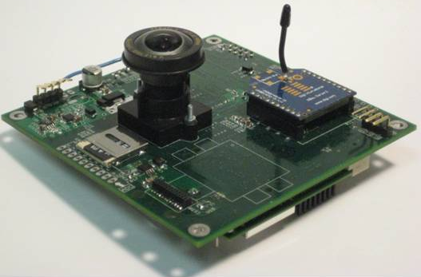


Plant-on-Chip
Control Input reg
uB RAM
New X Reg
Sample Reg
B ROM
Dist. ROM
Inverted Pendulum
State-space model
ported to PoC
FPGA (Altera
Cyclone III EP3C25F256)
Inverted Pendulum
State-space model
ported to PoC
FPGA (Altera
Cyclone III EP3C25F256)
θ
θ
A ROM
AX RAM
$$\dot{x}$$
Processor (NIOS II)
$$\dot{x}$$
Processor (NIOS II)
PoC
PoC
Old X RAM
UART Reg
Accum
Profiler
Profiler
Profiling Data Out
PC interface
Profiling Data Out
PC interface
RAVI Platform

