Slide 1

Scheduling Challenges in Mixed Critical Heterogeneous Real-Time Computing Platforms
Iowa State University, Ames IA
PI: Phillip Jones
Co-PIs: Joseph Zambreno, Nicola Elia
Students: Chetan Kumar N G, Sudhanshu Vyas, Matt Rich
Washington University, St. Louis MO
Co-PIs: Ron Cytron, Chris Gill
AFOSR: Grant # FA9550-11-1-0343

Slide 2
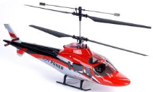
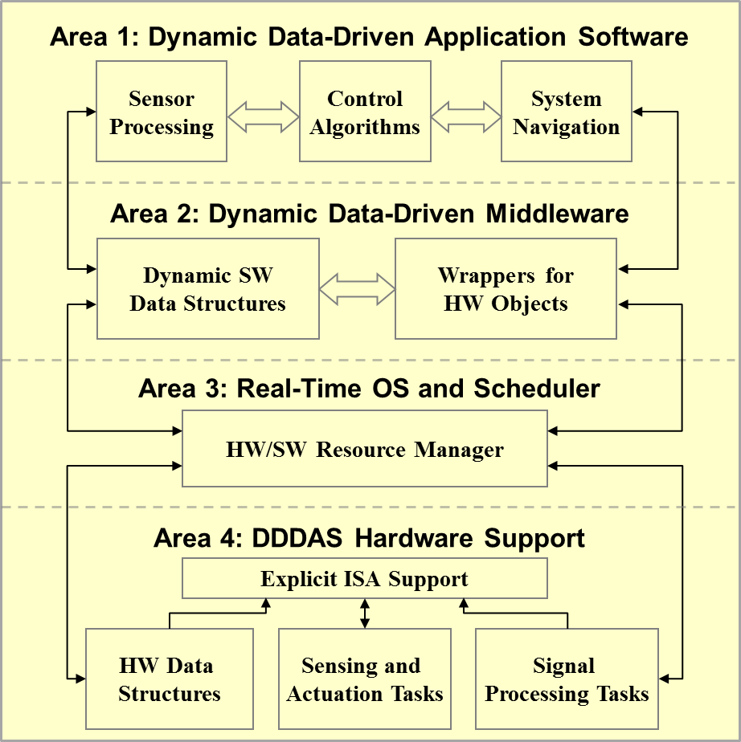
Project Overview
(An Adaptive Property-Aware HW/SW Framework for DDDAS)
In-flight data-driven applications must respond to surprise
  Changes in mission objectives
  Unexpected friends or foes
  Changes in environment
Modalities
  Real-time
  High-performance
  Energy-conserving
Focus areas
  Data structures: spanning HW/SW boundaries & Dynamic
  ISA extensions and hardware support
  Establish performance metrics
Notes:
This project focuses on the design of an adaptable computing infrastructure to support DDDAS systems in the context of Unmanned Aerial Vehicles (UAVs). A unifying theme that drives our research is the concept of responding and adapting to surprise. Some examples of surprise are: 1) in flight changes in mission objectives, 2) unexpected encounters with friends or foes, and 3) changes in the environment. Two examples of environmental changes could be a chipped blade (which changes the dynamics of the UAV), or unexpected turbulence.
In support of responding to surprise, research is being pursued to allow elements of the computing platform to adapt to the system or tasks moving between different modalities (e.g. real-time, high-performance, small-footprint, Energy-conserving).
Key areas of focus that support adaptation to surprise and changing modalities are:
Data structures that span HW/SW boundaries: In this area we are exploring SW data structures that can dynamically change their internal makeup to best suite a task’s current modality (e.g. maximizing average throughput when in high-performance mode, or bounding worst-case access time when in a real-time mode), or migrating their storage and operators between SW/HW boundaries to improve performance and/or improve predictability.
Instruction Set Architecture (ISA) extensions and hardware support: This area focuses on the design and evaluation of specialized hardware to support common tasks that can be found in UAV applications (e.g. sensor acquisition/processing, issuing actuator commands, signal processing, vehicle controller logic) for the purpose of increased computational efficiency (explicitly exploiting concurrency) and/or enforcing guarantees on task behavior (e.g. tight bounds on execution variation, guarantees on resources availability)
Establishing performance metrics: i) tolerance of vehicle stability to jitter in its control loop, ii) overheads associated with dynamically morphing data structures or migrating them across SW/HW boundaries.

Slide 3

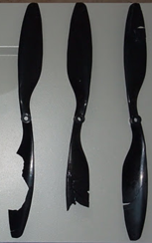

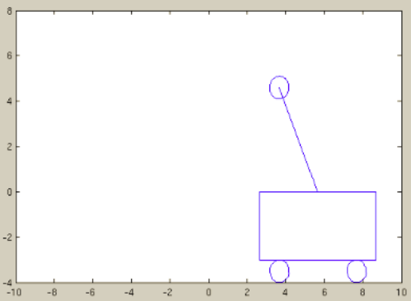
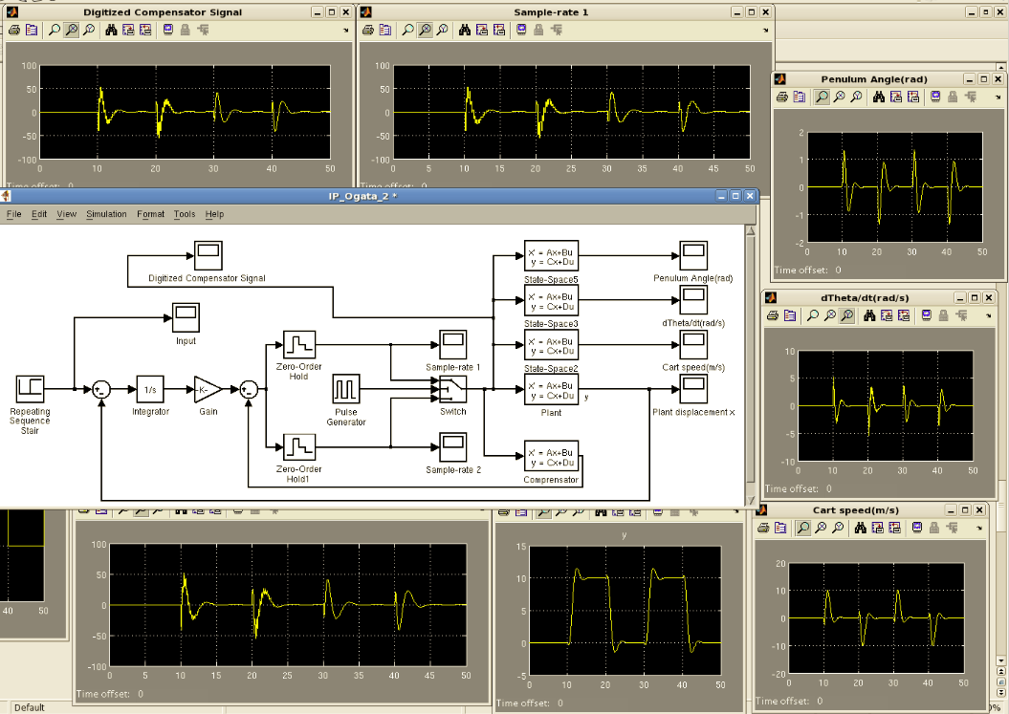
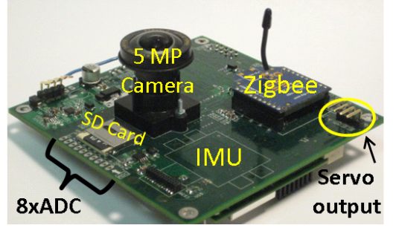
Approach and Methods
Create representative “surprise” scenarios
Map to simplified vehicle model
  Quantify impact of computation response to surprise on vehicle dynamics
Develop dynamic HW/SW mechanisms to mitigate impact of surprise
  E.g. dynamic data structure, hardware adaptation
Evaluate mechanisms
  C models
  MATLAB-Simulink
  FPGA prototypes
Vehicle Position Stability
Simulink Vehicle Model
FPGA Experimentation
Notes:
This slide illustrates at a high level the approach this project is taking
Developing “surprise” scenarios”: To evaluate our mechanisms that support DDDAS type applications, we use scenarios to construct system workloads. Three example small-UAV-based scenarios are:
Unexpected turbulence occurring due to gusting winds.
The vehicle undergoing a change in its physical dynamics (e.g. a blade chipping causing increased vehicle vibrations)
The vehicle entering an area of unexpected electromagnet interference (e.g. lightning strikes or getting close to large metallic objects) that interfere with certain sensors (e.g. magnetometers used for determining direction)
Mapping UAV to a simplified vehicle model: For initial experimentation and evaluation, a standard simple inverted pendulum on a cart serves as a MATLAB/Simulink testbed for implementing our representative “surprise” scenarios.
This allows the opportunity to focus on the design and behavior of our dynamic data structures and DDDAS support mechanisms on a relatively simple vehicle model and controller, before applying them to more complex UAV models and controllers.
Initial application of our techniques to a simple vehicle model allows us to build intuition on the interactions between our computing mechanisms, sensor behavior, and vehicle dynamics that will help guide our analysis as we move into using the more complex UAV models
The MATLAB/Simulink testbed is being developed in such a way that the inverted pendulum model and controllers are easily swappable for more advanced vehicle models and controllers.
Development of dynamic HW/SW mechanisms to mitigate impact of surprise: The mechanisms pursued will allow selected SW and HW resources of the computing platform to dynamically adjust to the needs of the application.
Adapting the storage/functionality of computation to tradeoff resource allocation for computing speed and/or guarantees in computing properties (e.g. throughput vs. deterministic timing).
Placing and managing Priority Queues in SW vs. HW, and potentially migrating between the two.
Migrating between different configurations of trees: e.g. Red-black to AVL.
Using the concept of dynamic stream filters to trade off throughput for accuracy (e.g. filtering data quickly vs. accurately).
Evaluating DDDAS Application support mechanisms:
a) The research will follow an incremental approach for evaluating our DDDAS support mechanisms. Beginning with initial SW and MATLAB/Simulink models, and incrementally moving these models into a prototype of an actual UAV system using an FPGA-based platform to host our DDDAS-centric System-on-Chip architecture.

Slide 4
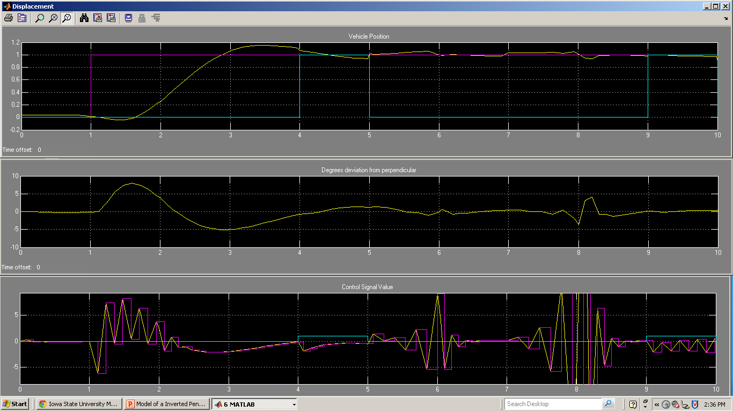
Performance Metrics for Evaluation
DDDAS applications: couples data streamed and its processing.
In addition to standard metrics (e.g. worst case task execution for schedulability analysis), metrics are needed to embody coupling.
  Impact of variations in control loop execution (i.e. timing jitter) on vehicle stability
    Controller settling time and overshoot metrics as a function of timing jitter
  Minimum allocation of computing resources to tolerate given surprise scenarios
    Minimum sensor sample rate needed to tolerate a 50 mile/hour gust of wind.
Wind gust
Vehicle Position (ft)
Goal
Position
Disturbance
Position
Controller Output Force (N)
Pulsed Force
Time seconds
Notes:
Metrics are needed that can evaluate the symbiotic relationship between data streaming from sensors and how that data is processed.
An example of using a simplified model (Inverted pendulum on a cart) to gather preliminary data with respect to identifying relevant metrics that map to realistic UAV scenarios, and gaining intuition about these metrics.
In this case we determine though a MATLB/Simulink simulation the minimum sample rate needed to withstand an emulated 1 N gust of wind that lasts for one second (at time 4 seconds). We show the behavior of the system at a sample rate just below the minimum required. Resulting in the Controller almost recovering at 6 seconds, but slowly goes unstable from time 7 to 8 seconds. The vehicle is trying to maintain a horizontal position of 1 foot.
Potentially the output streaming from the Controller, or sensors monitoring wind speed, or sensors that can detect a pulse disturbance (e.g. gyo’s, accelerometers) on the vehicle could be used as feedback to dynamically adjust the sample rate of sensors (thus increasing computing resources allocation for stabilization) in order to better tolerate surprise disturbances.

Slide 5
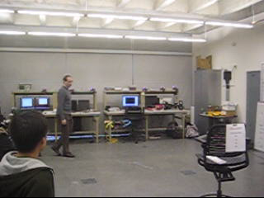
Quadrotor Platform

Slide 6
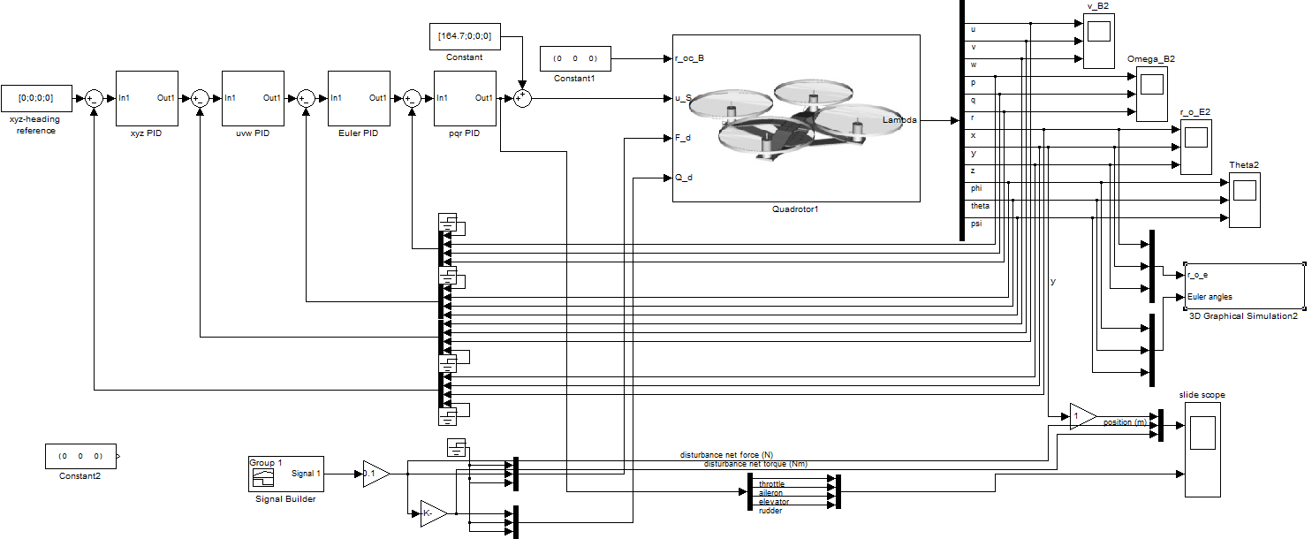
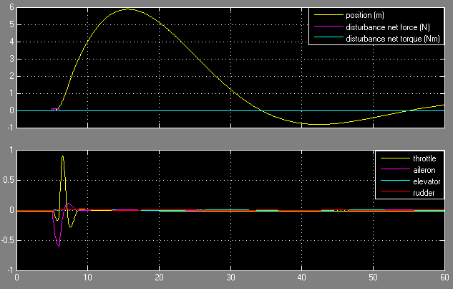
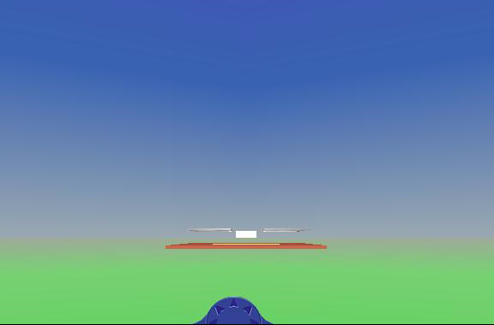
Multilayer PID Control of Quadrotor

Slide 7
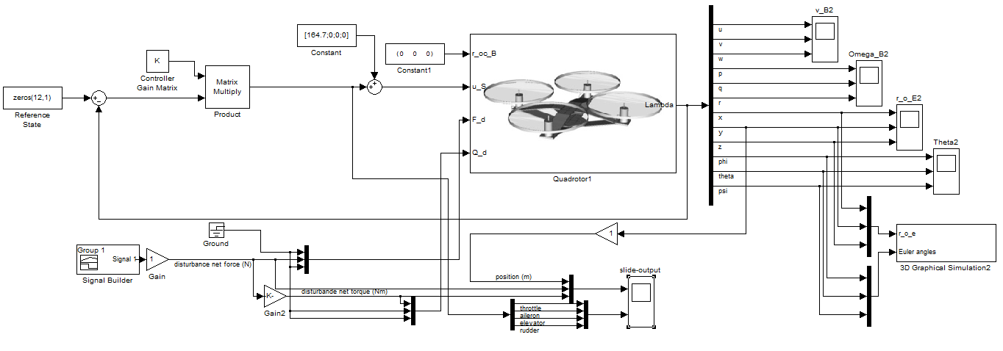
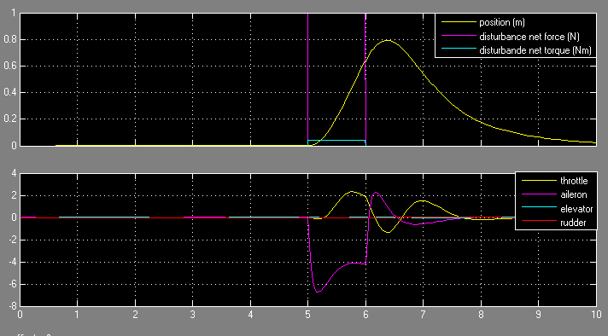
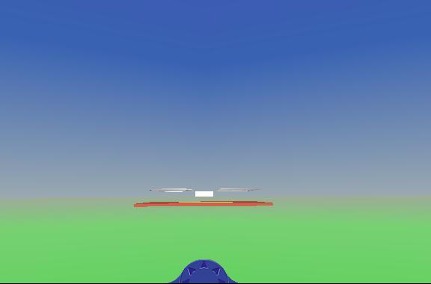
LQR Control of Quadrotor

Slide 8
Dynamic Data Structures
Priority queue: Hardware implementation for real-time controls
  Increasing throughput and reducing jitter
Ordered set: Exploring migration from red-black trees to AVL trees
  Supporting transition between mission modalities.
Adaptation to evolving conditions
Real-time
High-performance
Small
footprint
Notes:
Systems authored for DDDAS require data structures that can migrate between modalities in response to planned mission objectives as well as surprise. We are building on previous work to develop data structures that work well in each modality but that can also migrate between modalities as required.
We are extending our previous work on real-time dictionaries to include storage-frugality and migration between the three modalities shown on this slide.
For the priority queue, we obtain real-time performance by a hardware design consistent with the software/hardware codesign nature of our research. The hardware design is shown on the next slide and we are currently obtaining jitter measurements that compare it with a standard software-only implementation.
For ordered sets (i.e., binary search trees), we are developing algorithms that migrate between red-black trees (fairly well balanced) and AVL trees (very well balanced).
With these data structure implementations in place, applications that use them can intelligently adapt to evolving conditions and exhibit behaviors beyond what is statically specified prior to mission launch.

Slide 9
20
Hardware Priority Queue Architecture
Hardware implementation of a conventional binary heap.
Supports enqueue in O(1) time and dequeue in O(log n) time.
Enqueue Logic
New Entry
Queue Manager
Cell0
Cell1
Cell2
Cell3
Level0
Dequeue Logic
Address Decoder
4
Mux/
DeMux
>=
Level1
15
7
>=
Level2
16
25
30
35
Level3
17
18
28
Block RAMs
Enqueuing
Each level of the heap is stored in a separate Block RAM.
Address decoder generates addresses and control signals for the BRAMs.
Queue Manager provides the necessary interface and executes operations on the queue.

Slide 10
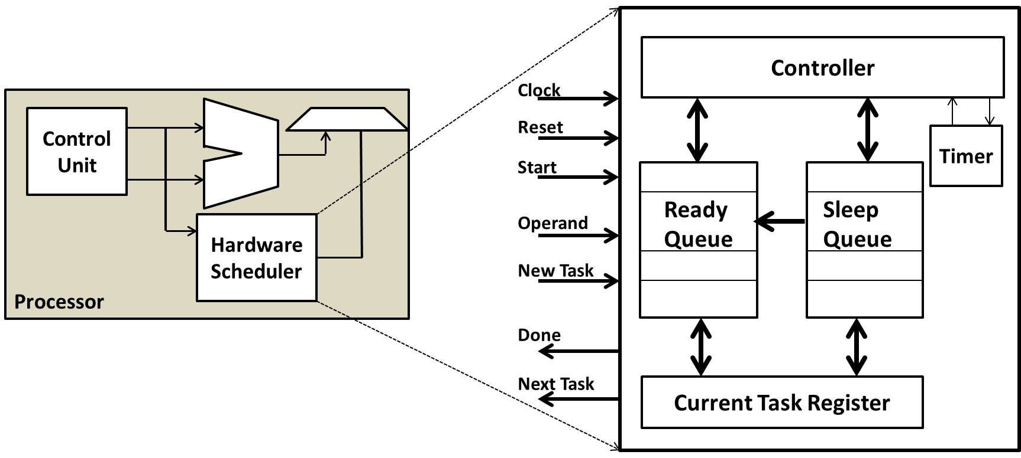
Hardware Scheduler
Designed to reduce the timer-tick processing and scheduling overhead.
Controller
Timer
Ready Queue
Sleep
Queue
Hardware Scheduler
Controller: responsible for the execution of the scheduling algorithm
Timer: keeps accurate high-resolution time.
Task queues: priority queues that keep tasks in sorted order based on their priority (Ready Queue) or activation time (Sleep Queue).
Custom instructions: extend the processor’s instruction set architecture to allow the CPU to interface with the scheduler.

Slide 11
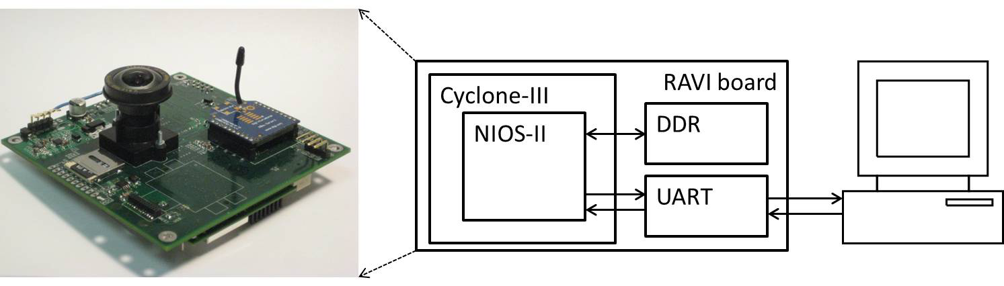
Evaluation Methodology
Platform
Reconfigurable Autonomous Vehicle Infrastructure (RAVI) board, an in-house developed FPGA prototyping platform.
Architecture Configuration
Nios II processor running at 50 MHz.
Custom instruction interface is used to communicate with the scheduler.
Supports up to 255 tasks.
Scheduling algorithm - Earliest Deadline First(EDF).
Workload
Periodic tasks with randomly generated parameters.
Relative task deadline equal to period of the task.
Metrics
Scheduler Overhead
Timer-tick Overhead
Predictability

Slide 12
Scheduling Challenges in Mixed Critical Heterogeneous Real-Time Computing Platforms
In-flight data-driven applications must respond to surprise
  Changes in mission objectives
  Unexpected friends or foes
  Changes in environment
Platform should adapt to changing conditions
  Anticipate strategic surprise
  Maintain system properties
Focus areas
  Need for new mixed critical task models
  Scheduling challenges
Notes:
This project focuses on the design of an adaptable computing infrastructure to support DDDAS systems in the context of Unmanned Aerial Vehicles (UAVs). A unifying theme that drives our research is the concept of responding and adapting to surprise. Some examples of surprise are: 1) in flight changes in mission objectives, 2) unexpected encounters with friends or foes, and 3) changes in the environment. Two examples of environmental changes could be a chipped blade (which changes the dynamics of the UAV), or unexpected turbulence.
In support of responding to surprise, research is being pursued to allow elements of the computing platform to adapt to the system or tasks moving between different modalities (e.g. real-time, high-performance, small-footprint, Energy-conserving).
Key areas of focus that support adaptation to surprise and changing modalities are:
Data structures that span HW/SW boundaries: In this area we are exploring SW data structures that can dynamically change their internal makeup to best suite a task’s current modality (e.g. maximizing average throughput when in high-performance mode, or bounding worst-case access time when in a real-time mode), or migrating their storage and operators between SW/HW boundaries to improve performance and/or improve predictability.
Instruction Set Architecture (ISA) extensions and hardware support: This area focuses on the design and evaluation of specialized hardware to support common tasks that can be found in UAV applications (e.g. sensor acquisition/processing, issuing actuator commands, signal processing, vehicle controller logic) for the purpose of increased computational efficiency (explicitly exploiting concurrency) and/or enforcing guarantees on task behavior (e.g. tight bounds on execution variation, guarantees on resources availability)
Establishing performance metrics: i) tolerance of vehicle stability to jitter in its control loop, ii) overheads associated with dynamically morphing data structures or migrating them across SW/HW boundaries.

Slide 13
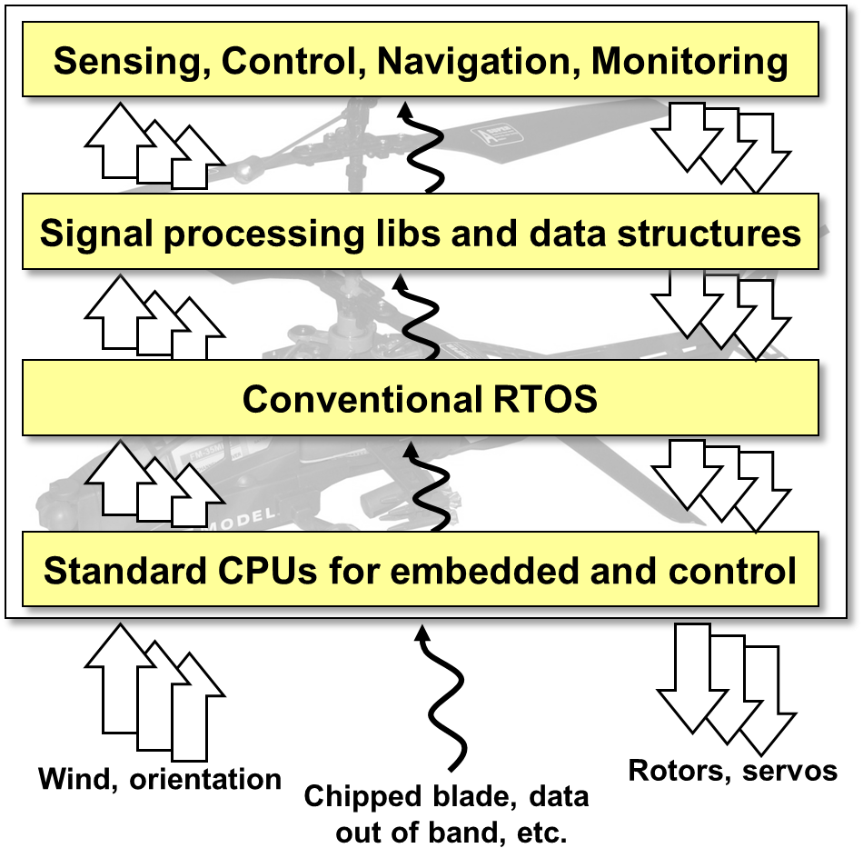
Traditional Architecture
Layers of abstraction
  Isolates application level concerns from physical-level concerns.
Behavior of hardware and software components treated dis-jointly
Advantage
  Reduced system complexity.
Limitation
  Less visibility and control over hardware-software interaction.

Slide 14
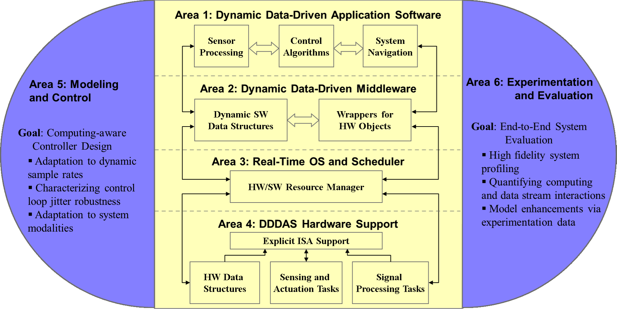
Grand Vision
Integrated hardware/software architecture for adaptive reconfigurable execution.

Slide 15
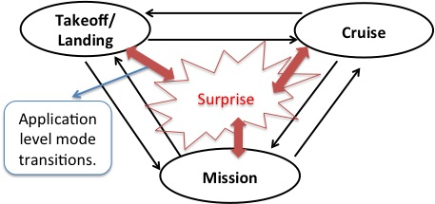
Heterogeneous Mixed Critical Platforms
Identify key modes of operation during design phase.
  Stable states of execution
Test and certify transitions between states.
Adapt to surprise
  Dynamically changing application characteristics.
Modalities
  Real Time
  High Performance
  Energy Conserving
Illustration of Surprise
Multidimensional resource management
  Processor
  Memory
  Power

Slide 16
Mixed Critical Scheduling (MCS)
Traditional scheduling algorithms:
  Assumes all tasks are equally critical.
  Tries to maximize processor utilization.
In MCS, tasks with higher criticality should be preferred over lower criticality tasks during overload conditions.
Assigning criticality as priority is one way to solve the above problem.
  Conservative WCET estimates needs to be taken.
  This will lead to under utilization of resources.

Slide 17
Current Mixed Criticality Task Models
Vestal’s Multi-Criticality Task Model
  Each task is assigned a criticality level.
  Task can have set of WCETs
  Higher the criticality level, more conservative WCET estimation
  Scheduling Algorithms
    Audesly’s priority assignment scheme
    Period transformation technique
    PLRS, CBEDF, EDF-VD
DeNiz’s Mixed Criticality Task Model
  Task can execute in normal or critical mode.
  Each task has a WCET and an overload execution budget
  Scheduling Algorithms
    Zero slack scheduling

Slide 18
Heterogeneous Mixed Critical Platforms
Properties not captured in existing mixed criticality task model.
Dynamically changing task criticality
  varying task criticality based on operating conditions could result in improved utilization.
Required and optional resources
  optional resource improves performance or quality of service.
WCET dependency of resource allocated
  use of hardware accelerators.
Resource preemption overhead
  e.g. hardware priority queue.

Slide 19
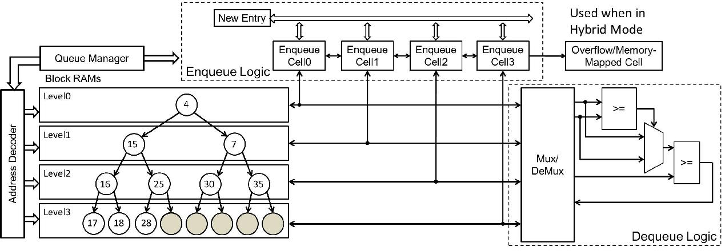
Hardware Priority Queue - Example
Hardware priority queue
  re-usable hardware accelerator
  data stored in hardware memory
Resource preemption overhead
  moving queue data between hardware and main memory
  non-negligible and needs to be accounted for schedulability analysis.

Slide 20
Proposed Task/Resource Model
Each task Ŧ_{i} is defined as: Ŧ_{i} = (T_{i}, A_{i}, D_{i}, P_{i}, V_{i}, RR_{i}[], L_{i}, M_{i}, C_{i}(RA_{i}[])) where,
T_{i} is the task period,
A_{i} is the arrival time,
D_{i} is the relative deadline,
Pi is the priority of the task,
U_{i}(t) is the task utility function, where t is the time elapsed since its arrival.
RR_{i}[] is resource requirement vector, which has the list of required and optional resources.
L_{i} is the task criticality level,
M_{i} is modality,
C_{i}( RA_{i}[]) is the worst case execution time, which depends on resources currently allocated, RA_{i}[], to the task.
Each resource RR_{x} is defined as: RR_{x} = (n_{x}, t_{x}, sc_{x}, d_{x}[]) where,
n_{x} is the count of the available resources RR_{x},
t_{x} is the resource type (Blocking/Non-blocking),
sc_{x} is the worst case switching cost associated with the resource,
d_{x}[] is the resource dependency vector.

Slide 21
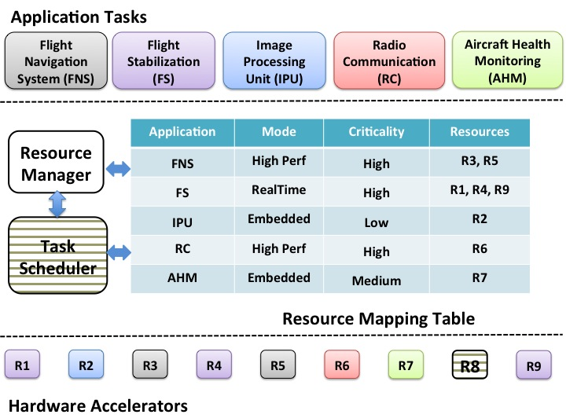
Conceptual Architecture Diagram
Resource manager and scheduler
  part of the adaptive computational stack for heterogeneous mixed critical real-time systems.
  takes into account dynamically changing criticality and application mode changes.

Slide 22
Scheduling Challenges
Identifying the stable states of execution.
  parameters for defining stable states
Guaranteeing system stability during state transitions.
  certifying safety critical applications.
Schedulability analysis
  scheduling space expands rapidly when there are n modes and n² transitions.
Estimation of worst case execution times.
  n optional resources result in 2^{n} resource combinations.
Defining the semantics of hardware accelerators.

Slide 23
Conclusion/Future Work
Mixed critical heterogeneous computing platforms
  identified key properties.
  limitations of traditional architecture and task models.
  challenges in developing scheduling and resource management algorithms.
Adaptable computing platform for DDAS
  need for adaptive computational stack.
  multidimensional redefining criticality in terms of system properties (e.g. Memory, Power)

